Slide 1
Bank Performance Analysis
%
Presented By Group 3
Maddirala Moses
Jaivardhan Deb
Mansi Rajput
Sukoon Fateema Munshi
Mahesh Rajaram Ushir

Slide 2

Content
Introduction
Dashboard
Data Transformation
Challenges
KPI’s

Slide 3
INTRODUCTION

Slide 4
INTRODUCTION
Welcome to this presentation on Bank Analytics, where we will delve into key financial metrics and insights derived from our comprehensive data analysis. In today's session, we will cover several critical areas:
Year-wise Loan Amount Statistics: Analyzing loan distributions over different years to identify trends and patterns in borrowing behavior.
Grade and Subgrade-wise Revolving Balance: Examining the relationship between credit grades and subgrades with revolving balances to assess risk and lending efficiency.
Total Payment Comparison: Contrasting total payments made by verified and non-verified customers to understand payment reliability and potential risk factors.
State-wise and Month-wise Loan Status: Investigating how loan statuses vary across different states and months to identify regional and seasonal trends.
Home Ownership vs. Last Payment Date Statistics: Exploring the impact of home ownership on payment timelines to gain insights into customer financial stability.
This presentation aims to provide a comprehensive overview of these key metrics, offering actionable insights to optimize our lending strategies and improve customer segmentation. Let's dive into each area to uncover valuable trends and data-driven strategies for better decision-making.

Slide 5
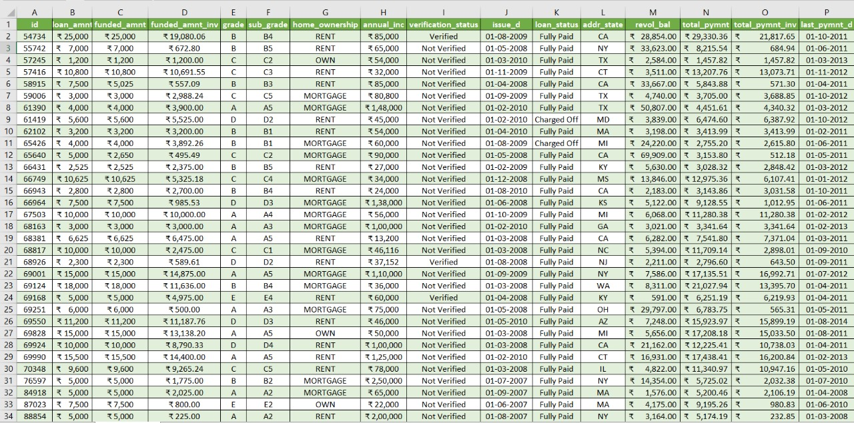
DATA TRANSFORMATION

Slide 6
KEY PERFORMANCE INDICATOR

Slide 7
Key Performance Indicator
Year-Wise Loan Amount Statistics
Grade & Subgrade-Wise Revolving Balances
Total Payments Made By Verified VS Non-Verified Customers
Analyze year-wise loan amount statistics to identify lending trends and growth patterns over time.
Examine grade and subgrade-wise revolving balances to evaluate credit risk and the effectiveness of our lending criteria.
Compare total payments made by verified versus non-verified customers to assess payment reliability and potential risk.
State-Wise & Month-Wise Loan Status Variations
Home Ownership VS Last Payment Date Stats
Explore state-wise and month-wise loan status variations to uncover regional and seasonal trends affecting loan performance.
Investigate the relationship between home ownership and last payment date to better understand factors influencing payment behavior.

Slide 8
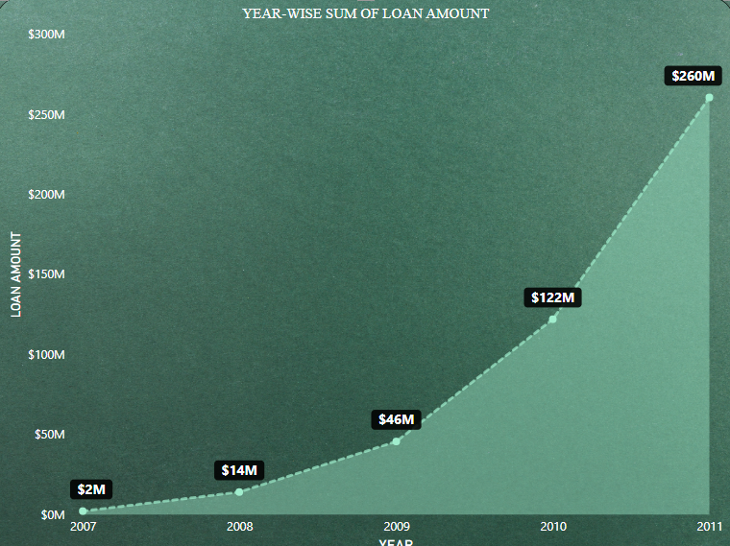
KPI 1 – Year-Wise Loan Amount Statistics
KEY POINTS:
1. Consistent Growth: The total loan amount has steadily increased each year, indicating a strong upward trend.
2. Rising Demand: This growth suggests increasing demand for loans, possibly due to expanding customer base or favorable economic conditions.
3. Market Penetration: The data reflects successful market penetration and customer engagement strategies.
4. Positive Economic Indicator: A continuous rise in loan amounts can signal a healthy economic environment, encouraging borrowing.
5. Strategic Planning: Understanding this trend helps in forecasting future growth and adjusting lending strategies accordingly.
Chart By: Power BI

Slide 9
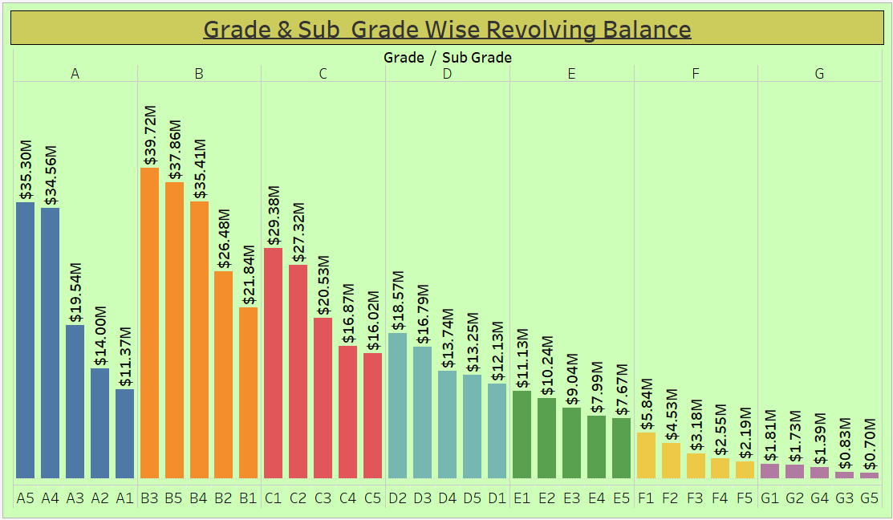
KPI 2 – Grade & Subgrade Wise Revolving Balance
Key Points
1. Risk Assessment: Higher revolving balances are often associated with lower credit grades, indicating greater credit risk in these segments.
2. Credit Usage Patterns: Customers in higher credit grades generally have lower revolving balances, suggesting more conservative credit usage and better financial management.
3. Subgrade Variability: Even within the same grade, subgrade analysis reveals significant variability in revolving balances, offering deeper insights into credit behavior.
4. Strategic Insights: Understanding the distribution of revolving balances across grades and subgrades allows for more targeted risk management and lending strategies.
5. Optimization Opportunities: Identifying segments with high revolving balances can help prioritize customer outreach and risk mitigation efforts.
Chart By: Tableau

Slide 10
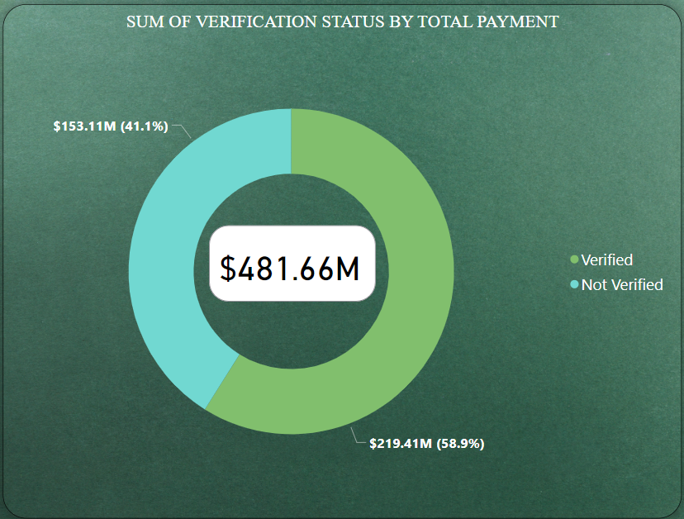
KPI 3 – Sum Of Verification Status By Total Payment
Key Points:
1. Payment Reliability: Verified customers generally contribute a larger share of total payments, indicating stronger payment reliability and lower default risk.
2. Risk Differentiation: The smaller share of payments from non-verified customers suggests a higher risk profile and potential issues with payment consistency.
3. Verification Impact: The chart demonstrates the effectiveness of customer verification processes in predicting and ensuring payment behavior.
4. Strategic Focus: Emphasizing customer verification could enhance overall payment collection and reduce risk exposure.
5.Policy Implications: Insights from this chart can inform adjustments to lending criteria, focusing more on verified customers to optimize loan performance
Chart By: Power BI

Slide 11
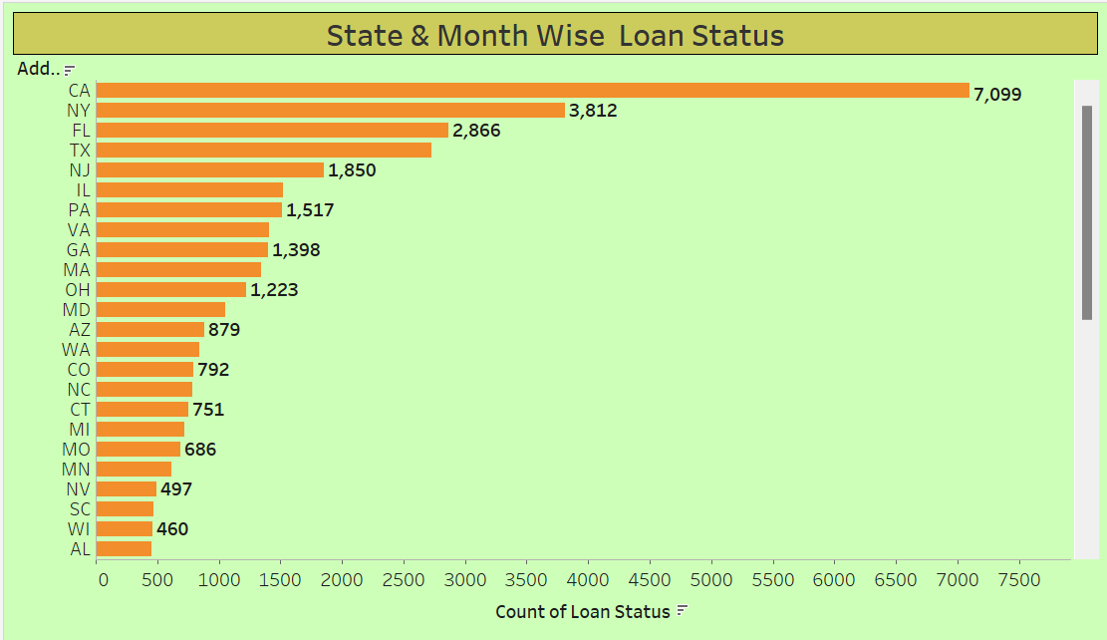
KPI 4 – State & Month Wise Loan Status
Key Points:
1. Geographic Trends: Certain states show higher levels of delinquent or defaulted loans, indicating regional economic challenges or varying borrower behaviors.
2. Seasonal Patterns: Loan statuses fluctuate month-to-month, revealing potential seasonal effects on borrowers' ability to make payments.
3. Regional Economic Insights: States with higher rates of current loans may reflect stronger local economies or more effective loan management practices.
4. Targeted Strategies: Understanding the variation in loan statuses by state and month can help develop more targeted collections and lending strategies tailored to specific regions and times of the year.
5. Performance Monitoring: Regular monitoring of these trends allows for proactive management of the loan portfolio to reduce defaults and optimize recovery efforts.
Chart By: Tableau

Slide 12
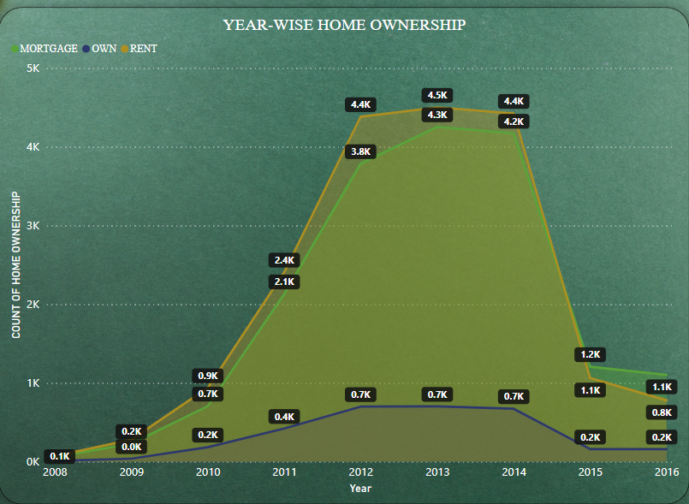
KPI 5 – Year-Wise Home Ownership
Key Points::
1. Payment Behavior: Homeowners often show more consistent and timely payment patterns compared to non-homeowners, indicating greater financial stability.
2. Risk Assessment: Non-homeowners might have a wider range of last payment dates, suggesting higher variability and potential credit risk.
3. Financial Stability Indicator: Homeownership can be a useful indicator of a borrower's long-term financial stability and reliability in meeting loan obligations.
4. Targeted Strategies: Understanding these trends allows for tailored lending strategies that consider a borrower's homeownership status as a factor in credit decisions.
5. Portfolio Optimization: Insights from this analysis can help optimize the loan portfolio by balancing risk and targeting more stable borrower segments.
Chart By: Power BI

Slide 13
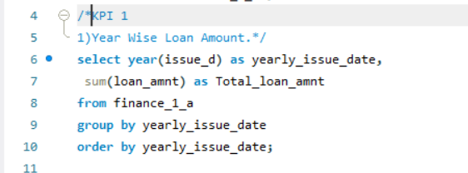
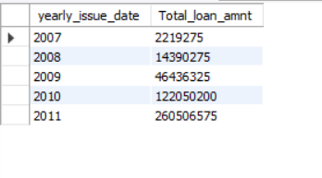
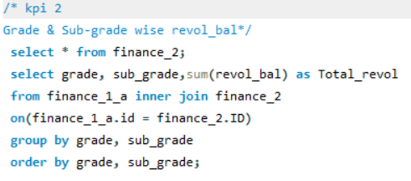
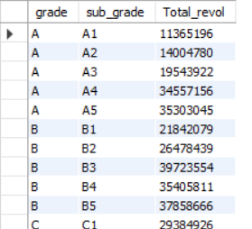
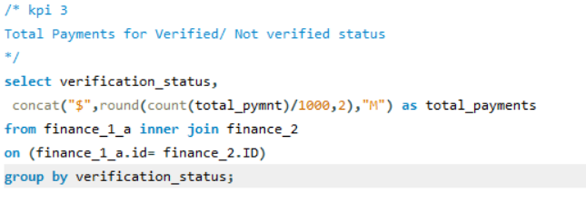
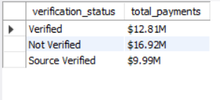
KPI’s In SQL- Script With Output
SCRIPT
S. NO
OUTPUT
1.
2.
3.

Slide 14
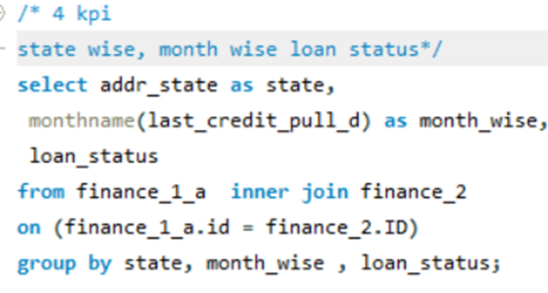
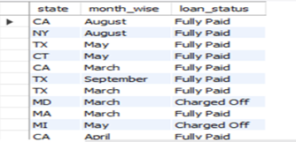
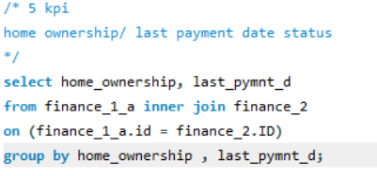
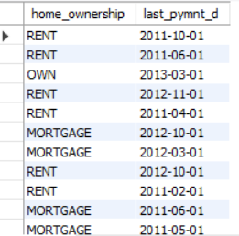
KPI’s In SQL- Script With Output
SCRIPT
S. NO
OUTPUT
4.
5.

Slide 15
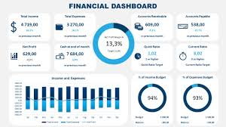
DASHBOARD

Slide 16
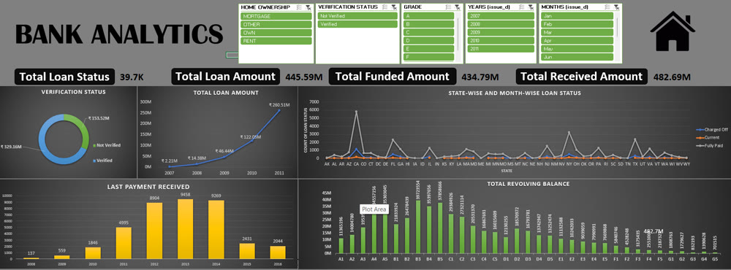
Excel

Slide 17
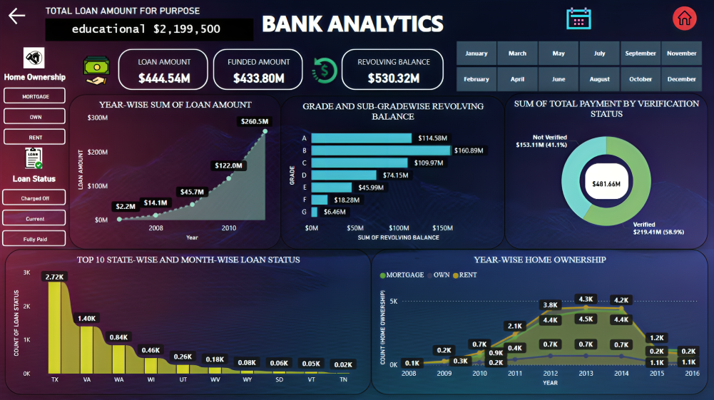
Power BI

Slide 18
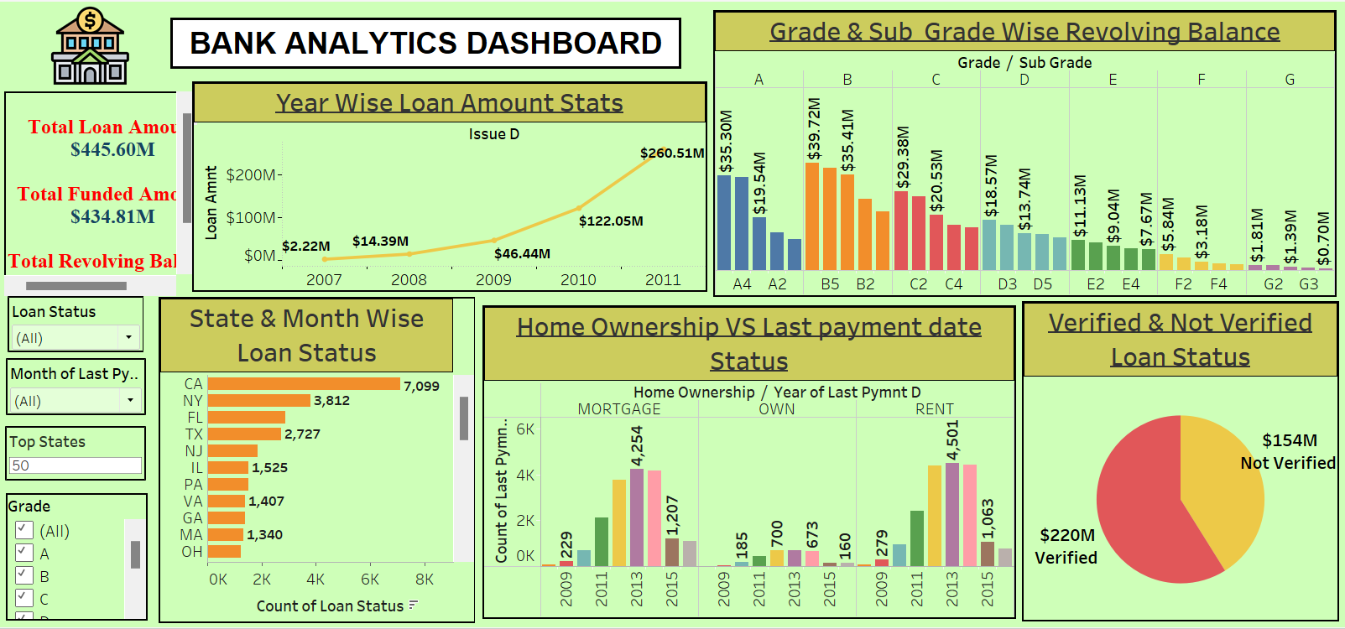
Tableau

Slide 19
Challenges
Regularly monitor & analyse the daily customer review to gain profits in this banking sector
Provide customers with self service opportunities
Promote financial literacy through customer education.

Slide 20
THANK YOU

